Slide 1

2019
Case Study: Market Share Prediction
Razmik Melikbekyan

Slide 2
Content
Objective
Data exploration and analysis
Data preparation
Modeling
Evaluation
Next Steps

Slide 3






Objective
Predicting whether new product launch will be successful or not.
29
new product launches
SUCCESS = Market Share 1 year after launch > 0.7%
Historical Data
Machine Learning
Prediction

Slide 4
Objective: Business point of view
Predicting whether new product launch will be successful or not.
There is no ideal model:
some models will predict successful launches more accurately than failures and some others will perform well when product launch is not successful. From Business point of view models will be divided into 2 types: conservative and risky.
Conservative models rarely will classify Failure as a Success, but a lot of successful launches they will classify as Failures (the risk of losing money due to not successful launch is low, but some profitable successful launches will not be launched).
Risky models sometimes will classify Failure as a Success, but they will differentiate successful launches from Failures more frequently than conservative models (the risk of losing money due to not successful launch is high compared to conservative models, but more profitable successful launches will be launched).
The model selection should be calibrated with business needs.
Machine Learning

Slide 5
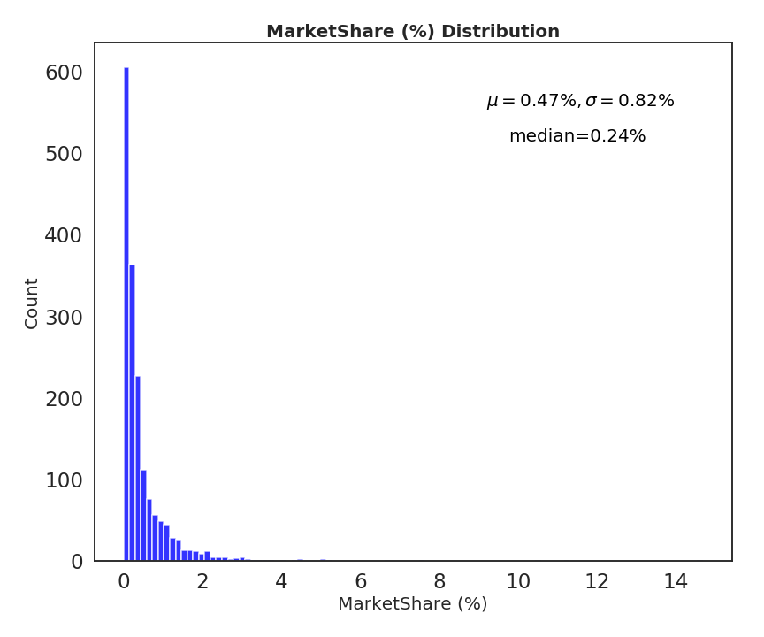
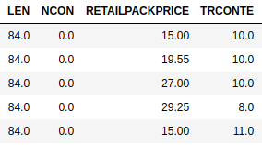
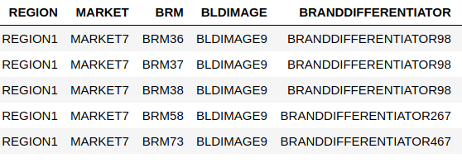
Data exploration and analysis
Historical Data 1716 items, 39 predictors, 1 response variable
4 Numerical Predictors
Our dataset is imbalanced: only 19% of all launched products were successful (SUCCESS <=> MS > 0.7%).
35 Categorical Predictors

Slide 6
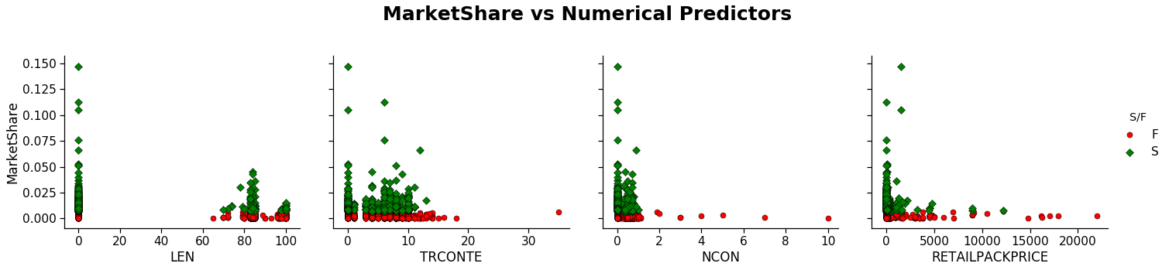
Data exploration and analysis
Market Share & Numerical Predictors

Slide 7
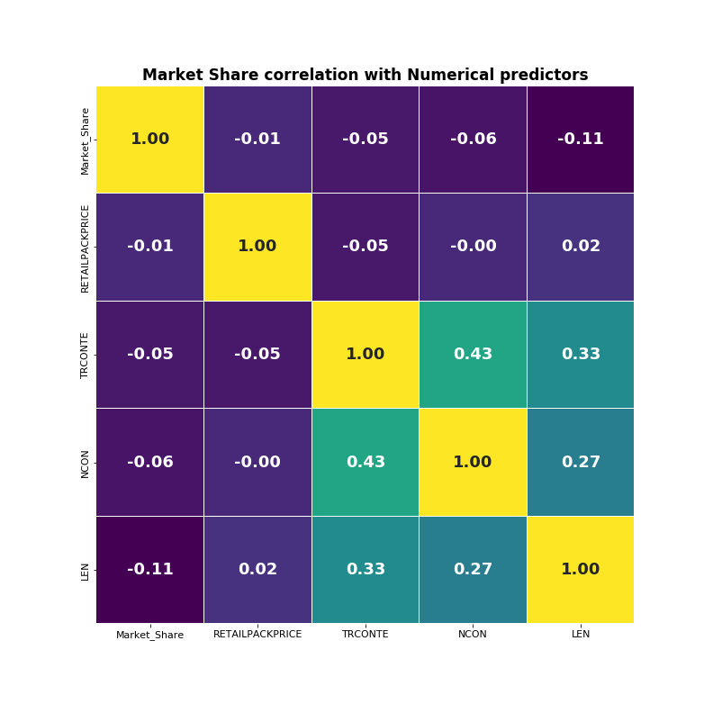
Data exploration and analysis
Market Share & Numerical Predictors
Correlation shows how close two variables are to having a linear relationship with each other.
We can see that there is no linear relationship between numeric predictors and response variable.
This is gives us insight that most probably linear regression models will not have high accuracy on this dataset.

Slide 8
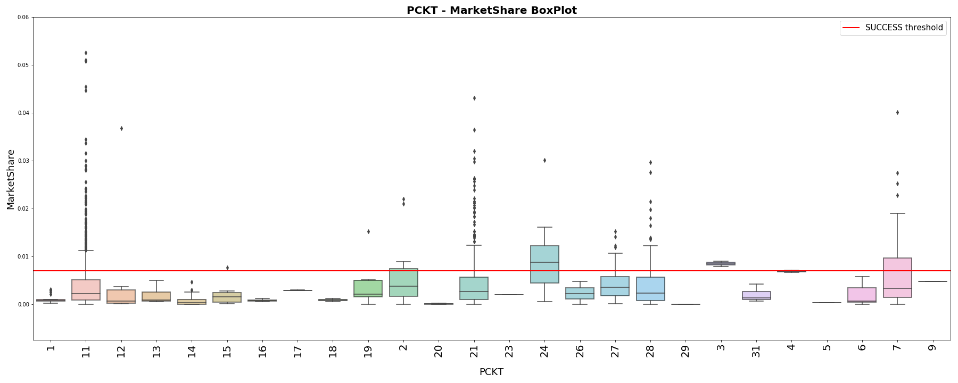
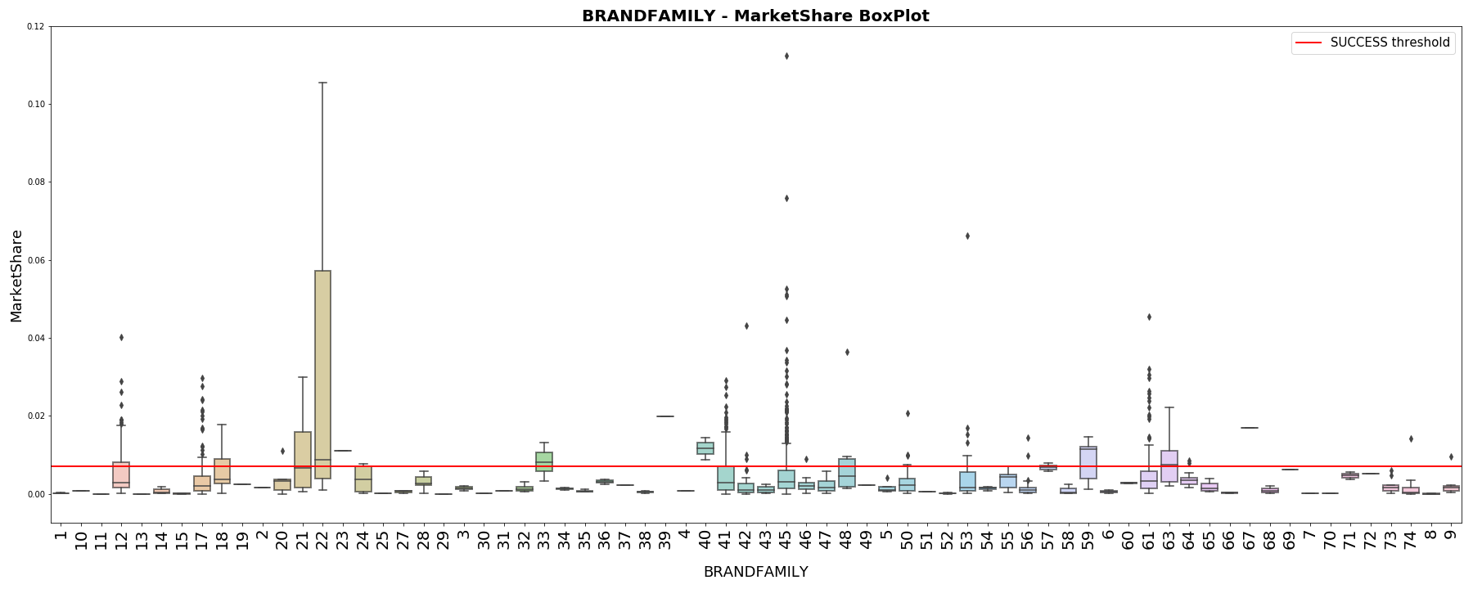
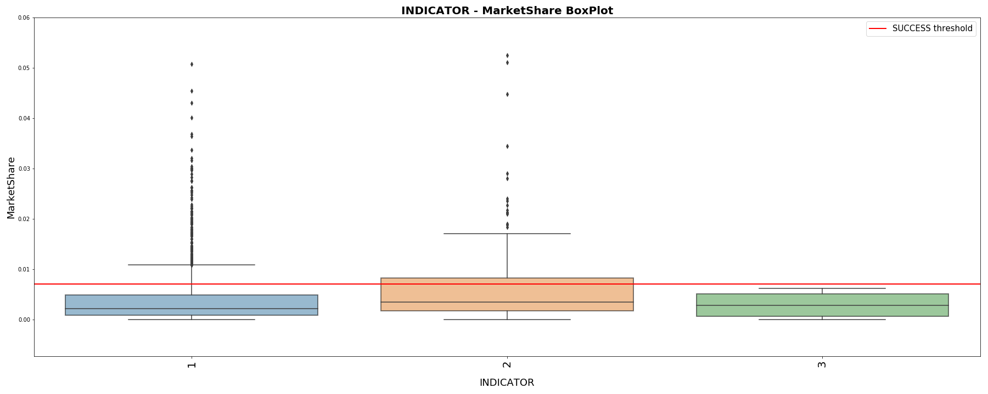
Data exploration and analysis
Market Share & Categorical Predictors
BoxPlot:
The line that divides the box into 2 parts represents the median of the data. The end of the box shows the upper and lower quartiles. The extreme lines shows the highest and lowest value excluding outliers.

Slide 9
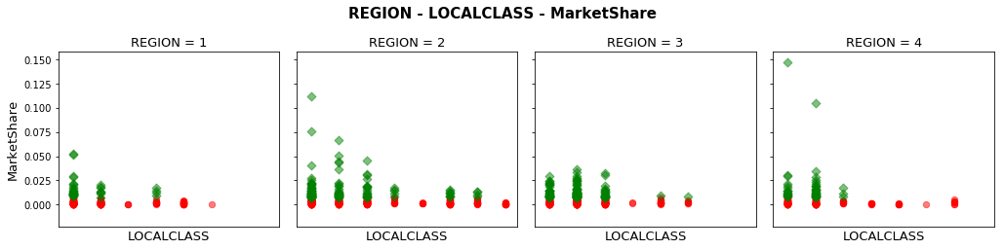
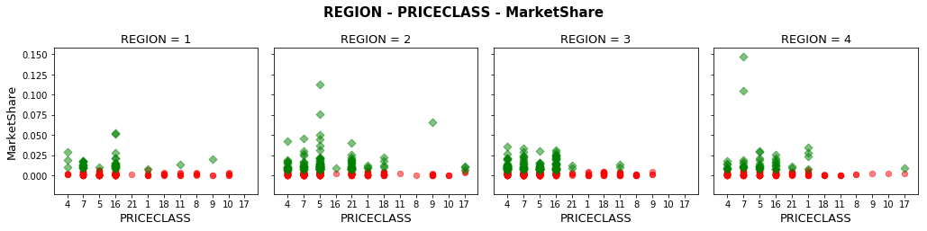
Data exploration and analysis
Market Share & Categorical Predictors

Slide 10
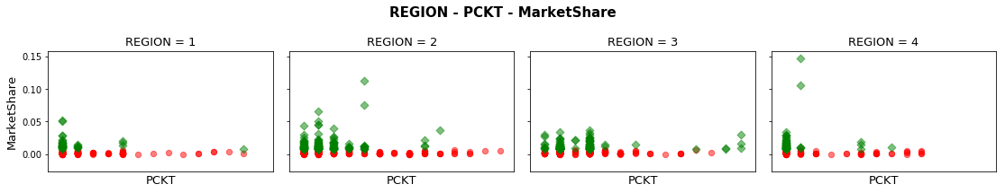
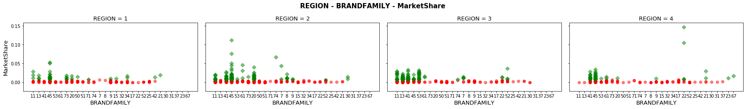
Data exploration and analysis
Market Share & Categorical Predictors

Slide 11
Data preparation
Data processing before applying models
Data Cleaning
Feature Engineering
Handling Categorical variables
Train-Validation-Test split
BoxCox transformations of response variable and numeric variables for having small skew and being more normally distributed.
Removing some predictors (duplicates, unique for all products, have a lot of missing values).
Fill missing values for some predictors.
Adding some additional predictors (mean and median RETAILPACKPRICE for all REGIONS, product relative RETAILPACKPRICE against its REGION median RETAILPACKPRICE, polynomial degrees of some numerical predictors, etc.).
Converting categorical variables to numerical ones in order to use them in machine learning algorithms. One-hot Encoding is used for conversion:
REGION_1 -> [1, 0, 0, 0]
REGION_2 -> [0, 1, 0, 0]
REGION_3 -> [0, 0, 1, 0]
REGION_4 -> [0, 0, 0, 1]
Initial training data is split into train and test parts with 0.85 and 0.15 ratio.
5 fold Cross Validation on train part is used for models selection and their parameters tuning.
Models final evaluation is done on test part, which is not used during training.

Slide 12
Data preparation
Back up slide
Data Cleaning, Feature Engineering ,
Handling Categorical variables, Train-Validation-Test split
BoxCox transformations of response variable and numeric variables, for having small skew and being more normally distributed
BRMID - unique ID for each product, drop
LATESTPERIODINDEX - the same for all products and informing us that Market shares are 12 months after launch, drop
BRM, BRANDONMARKET, MARKETEDBRAND - these 3 features are the same, so we keep only one of them
BRANDSUBFAMILY, BRANDSUBFAMILYGROUPING - these 2 features are the same, so we keep only one of them
NPLLAUNCHDATE - split into LAUNCH_YEAR and LAUNCH_MONTH
NPLLAUNCHYEAR - drop this feature, as it is the same with LAUNCH_YEAR
RTYPE - 73% missing values, drop
ITEMSHAPE - 53% missing values, drop
SPECIALFLAVOR - fill missing values of this feature with NOSPECIALFLAVOR as one additional category
TIPCOLOR - fill missing values of this feature with NOTIPCOLOR as one additional category
Data Cleaning
For TCLASS, REGION, LOCALCLASS, BLDIMAGE, MARKET, MINDICATOR, THICATEGORY, PCKT categorical features aggregation is done by numeric features, for example: for each from 4 different REGIONs calculated RETAILPACKPRICE mean, median, std and skew.
For each aggregation relative median is calculated, for example: for each product RETAILPACKPRICE is divided to its REGION median of RETAILPACKPRICE. In the feature we will see that these relative features are very important for models.
For numeric features LEN and RETAILPACKPRICE polynomial degrees are added (0.5, 2, 3)
Feature Engineering

Slide 13
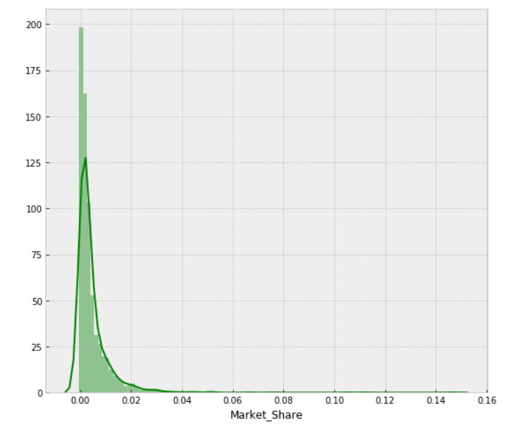
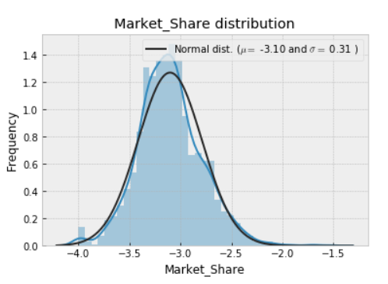
Data preparation
Back up slide
Market share distribution
As a classification data our dataset is imbalanced: only 19% of products in dataset are successful with given threshold 0.7%.
Exponential distribution shape, skew=7.5
Normal distribution shape, skew=0.35
BoxCox (lambda=0.25)
* BoxCox formula: y = (x**lambda - 1) / lambda (for lambda > 0)

Slide 14
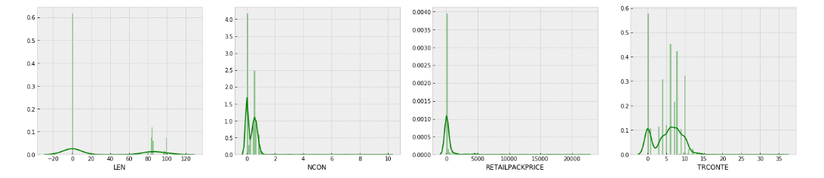
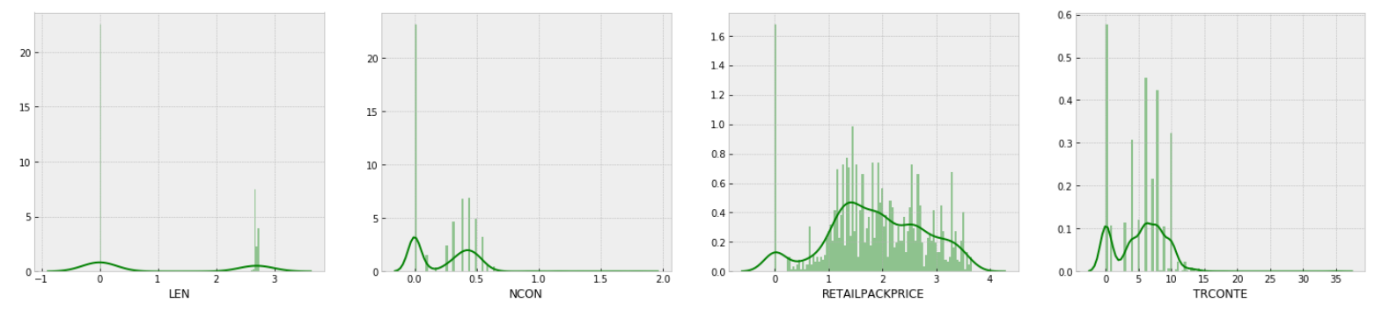
Data preparation
Back up slide
Numeric features distribution
LEN
NCON
RETAILPACKPRICE
TRCONTE
boxcox1p transformation in order to have less skew in features distributions.
boxcox1p (lambda = -0.25)
((1+x)**lambda - 1) / lambda
Skewness is asymmetry in a statistical distribution, in which the curve appears distorted or skewed either to the left or to the right.

Slide 15
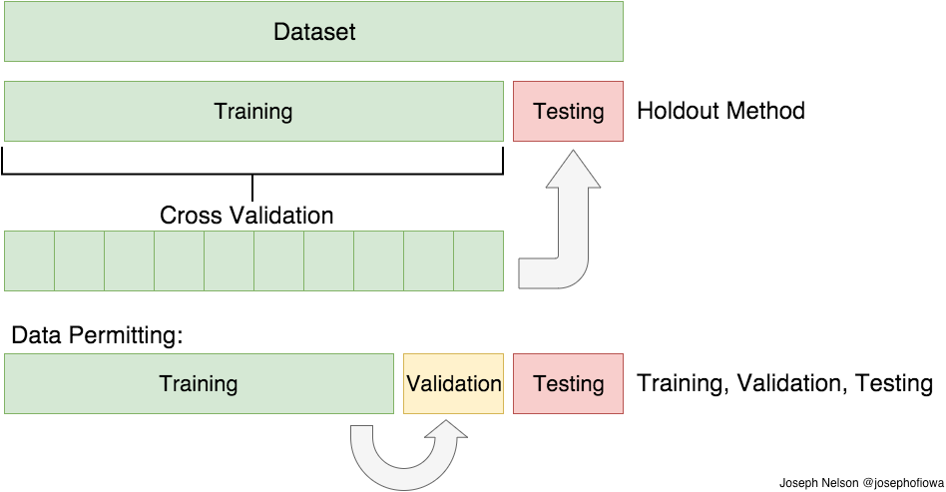
Data preparation
Back up slide
Data Cleaning, Feature Engineering ,
Handling Categorical variables, Train-Validation-Test split
As we have a many categorical features, we have to handle them somehow before giving to machine learning algorithms, because most of the models need numeric data as an input. There are many different methods for solving this problem (such as LabelEncoder, One-hot Encoding, Feature Hashing Scheme and etc.). In this project One-hot Encoding is used:
REGION_1 -> [1, 0, 0, 0]
REGION_2 -> [0, 1, 0, 0]
REGION_3 -> [0, 0, 1, 0]
REGION_4 -> [0, 0, 0, 1]
Handling Categorical variables
15%
85%
Initial training data is split into train and test parts with 0.85 and 0.15 ratio. During models selection, their training and hyper-parameters tuning process models are evaluated with 5 fold cross validation scheme. This means that train data is randomly split into 5 parts, trained on 4 parts of it and validated on the 5th part of it. Afterwards as a validation part we select next part (next from 5 parts), model is initialized again, trained on 4 parts and validated on validation part. This process repeated 5 times, until all 5 parts are considered as a validation part. Afterwards the evaluation is done based on average of metrics for each validation part . Final testing of models is done on test part, which is not used during training and CV process.
Train-Validation-Test split

Slide 16
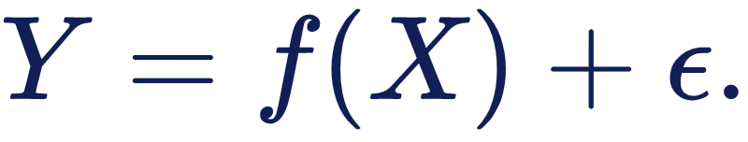
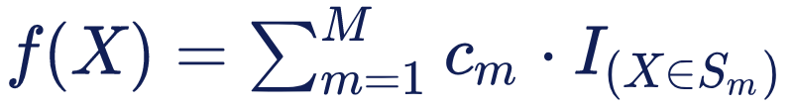
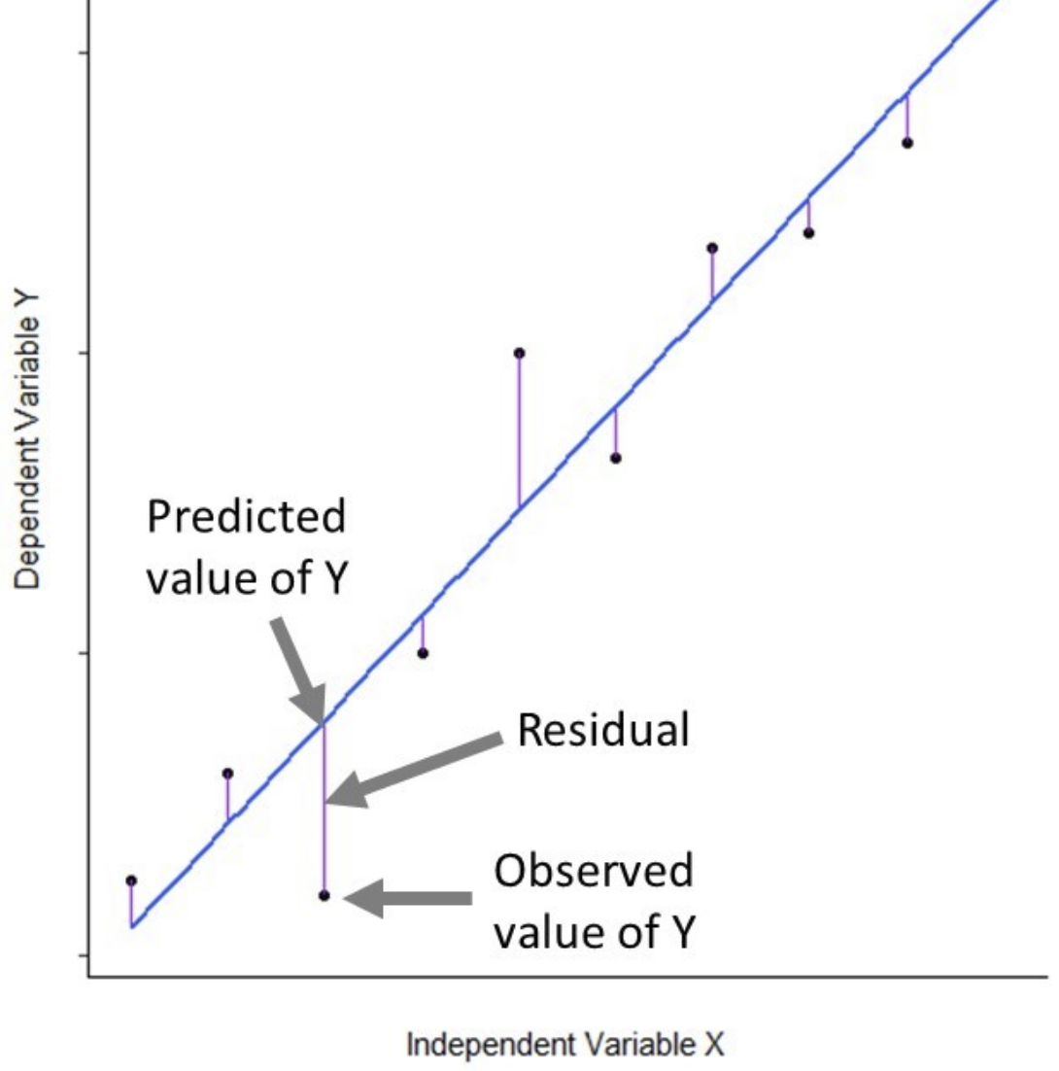
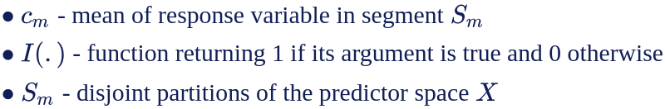
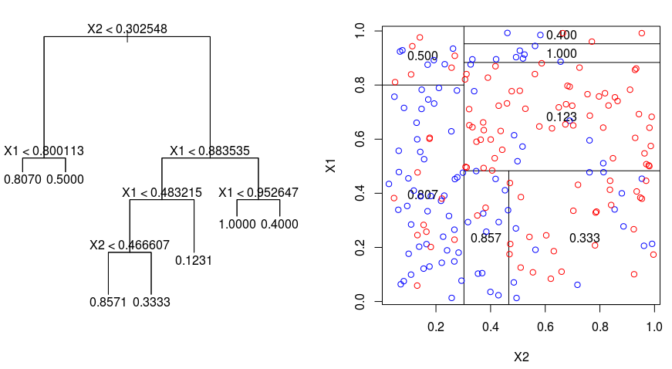
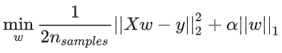
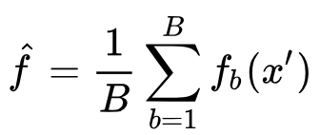
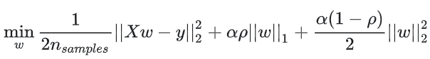
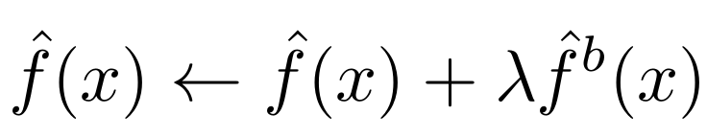
Modeling and Evaluation
Models: 4 different models applied
One of the general tasks of Statistical Learning is making predictions. Suppose that we observe a quantitative response Y (Market Share) and p different predictors, X_1 , X_ 2 , . . . , X_p (LEN, REGION, RETAILPACKPRICE, PCKT, …). We assume that there is some relationship between Y and X = (X_1 , X_ 2 , . . . , X_p):
Here f is some fixed but unknown function of (X_1 , X_ 2 , . . . , X_p) , and epsilon is a random error term, which is independent of X and has mean zero. Our goal is estimating function f.
Linear Models
Decision Tree based Models
Lasso regression:
ExtraTrees regression:
Elastic Net regression:
Gradient Tree Boosting regression:
Notes:
Linear model assume that the true relationship between X and Y takes the form Y = β 0 + β 1 X + e, where e is a mean-zero random error term. The error term is a catch-all for what we miss with this simple model: the true relationship is probably not linear, there may be other variables that cause variation in Y , and there may be measurement error. We typically assume that the error term is independent of X.
Decision tree based models involve segmenting the predictor space into a number of simple regions. In order to make a prediction for a given observation, we typically use the mean or the mode of the training observations in the region to which it belongs. Since the set of splitting rules used to segment the predictor space can be summarized in a tree, these types of approaches are known as decision tree methods.
Bagging:
To apply bagging to regression trees, we simply construct B regression trees using B bootstrapped training sets, and average the resulting predictions. These trees are grown deep, and are not pruned. Hence each individual tree has high variance, but low bias. Averaging these B trees reduces the variance.
RandomForest:
As in bagging, we build a number of decision trees on bootstrapped training samples. But when building these decision trees, each time a split in a tree is considered, a random sample of m predictors is chosen as split candidates from the full set of p predictors. The split is allowed to use only one of those m predictors. A fresh sample of m predictors is taken at each split.
ExtraTrees:
While similar to ordinary random forests in that they are an ensemble of individual trees, there are two main differences: first, each tree is trained using the whole learning sample (rather than a bootstrap sample), and second, the top-down splitting in the tree learner is randomized. Instead of computing the locally optimal cut-point for each feature under consideration, a random cut-point is selected. This value is selected from a uniform distribution within the feature's empirical range (in the tree's training set). Then, of all the randomly generated splits, the split that yields the highest score is chosen to split the node. Similar to ordinary random forests, the number of randomly selected features to be considered at each node can be specified.
Boosting:
Instead of creating a single powerful model, boosting combines multiple simple models into a single composite model. The idea is that, as we introduce more and more simple models, the overall model becomes stronger and stronger. In boosting terminology, the simple models are called weak models or weak learners.
To improve its predictions, gradient boosting looks at the difference between its current approximation, y_pred, and the known correct target vector, y_true, which is called the residual, y_true - y_pred. It then trains a weak model that maps feature vector to that residual vector. Adding a residual predicted by a weak model to an existing model's approximation nudges the model towards the correct target. Adding lots of these nudges, improves the overall models approximation. The residual is negative gradient of L2 loss.

Slide 17
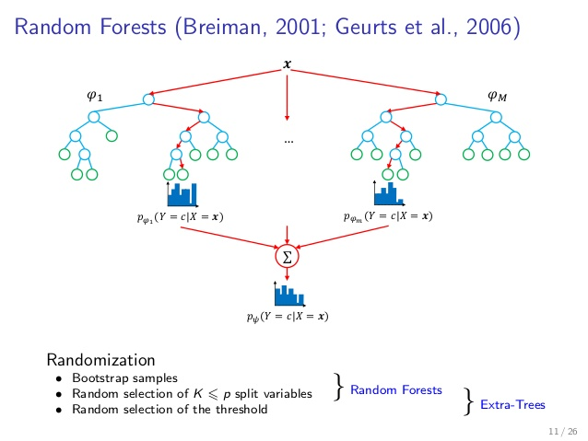
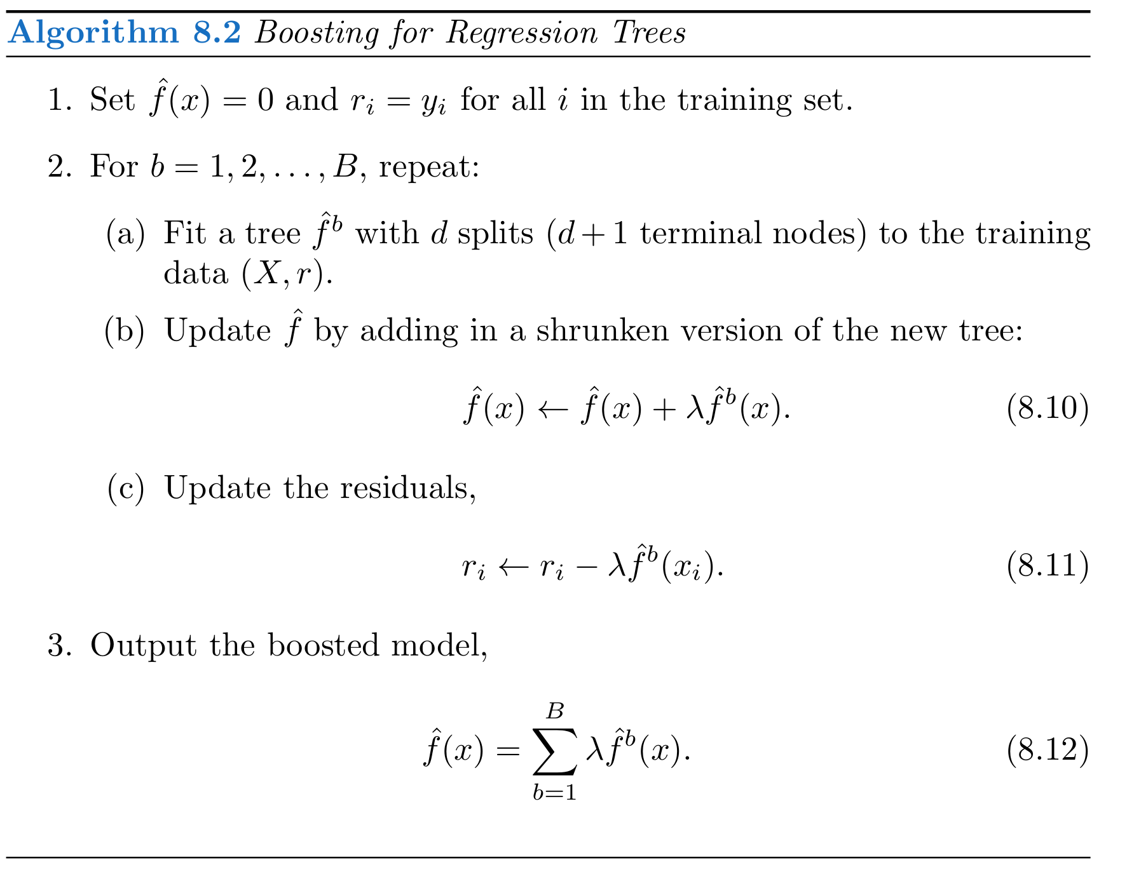
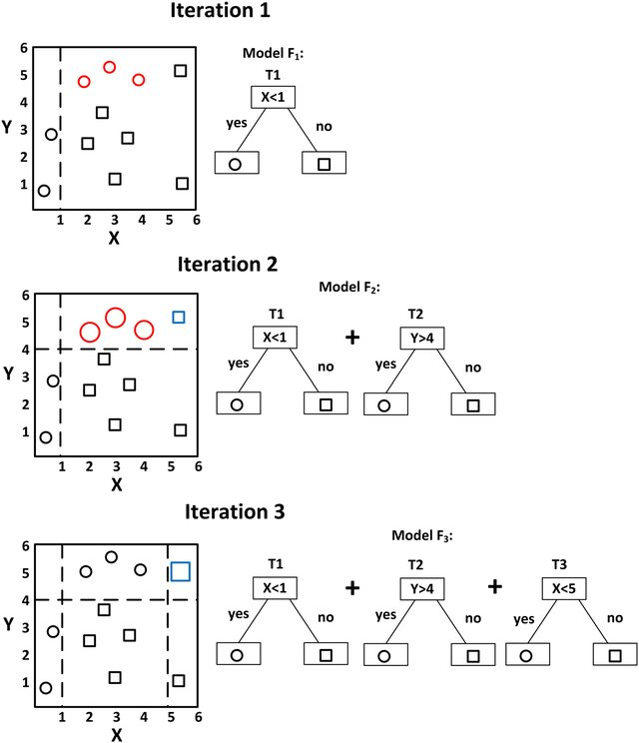
Modeling and Evaluation
Back up slide
Extra-Trees
Gradient Tree Boosting

Slide 18
Modeling and Evaluation
Back up slide
LASSO Regression
Lasso is a linear regression model with L1 regularization on regression coefficients. This regularization improves prediction error by shrinking large regression coefficients in order to reduce overfitting.
Elastic-Net Regression
Elastic-Net is a linear regression model, which linearly combines the L1 and L2 regularization of the Lasso and Ridge methods. Elastic-Net is useful when there are multiple features which are correlated with one another. Lasso is likely to pick one of these at random, while elastic-net is likely to pick both.
BASE MODELS
Extra-Trees Regressor
This model is ensemble of Decision Trees like RandomForest. As in random forests, a random subset of candidate features is used, but instead of looking for the most optimal thresholds, thresholds are drawn at random for each candidate feature and the best of these randomly-generated thresholds is picked as the splitting rule.
Gradient Tree Boosting
This model is also ensemble of Decision Trees (learner). Gradient boosting combines weak "learners" into a single strong learner in an iterative fashion. The intuition behind gradient boosting algorithm is to repetitively leverage the patterns in residuals and strengthen a model with weak predictions and make it better.
Notes:
Linear model assume that the true relationship between X and Y takes the form Y = β 0 + β 1 X + e, where e is a mean-zero random error term. The error term is a catch-all for what we miss with this simple model: the true relationship is probably not linear, there may be other variables that cause variation in Y , and there may be measurement error. We typically assume that the error term is independent of X.
Decision tree based models involve segmenting the predictor space into a number of simple regions. In order to make a prediction for a given observation, we typically use the mean or the mode of the training observations in the region to which it belongs. Since the set of splitting rules used to segment the predictor space can be summarized in a tree, these types of approaches are known as decision tree methods.
Bagging:
To apply bagging to regression trees, we simply construct B regression trees using B bootstrapped training sets, and average the resulting predictions. These trees are grown deep, and are not pruned. Hence each individual tree has high variance, but low bias. Averaging these B trees reduces the variance.
RandomForest:
As in bagging, we build a number of decision trees on bootstrapped training samples. But when building these decision trees, each time a split in a tree is considered, a random sample of m predictors is chosen as split candidates from the full set of p predictors. The split is allowed to use only one of those m predictors. A fresh sample of m predictors is taken at each split.
ExtraTrees:
While similar to ordinary random forests in that they are an ensemble of individual trees, there are two main differences: first, each tree is trained using the whole learning sample (rather than a bootstrap sample), and second, the top-down splitting in the tree learner is randomized. Instead of computing the locally optimal cut-point for each feature under consideration, a random cut-point is selected. This value is selected from a uniform distribution within the feature's empirical range (in the tree's training set). Then, of all the randomly generated splits, the split that yields the highest score is chosen to split the node. Similar to ordinary random forests, the number of randomly selected features to be considered at each node can be specified.
Boosting:
Instead of creating a single powerful model, boosting combines multiple simple models into a single composite model. The idea is that, as we introduce more and more simple models, the overall model becomes stronger and stronger. In boosting terminology, the simple models are called weak models or weak learners.
To improve its predictions, gradient boosting looks at the difference between its current approximation, y_pred, and the known correct target vector, y_true, which is called the residual, y_true - y_pred. It then trains a weak model that maps feature vector to that residual vector. Adding a residual predicted by a weak model to an existing model's approximation nudges the model towards the correct target. Adding lots of these nudges, improves the overall models approximation. The residual is negative gradient of L2 loss.

Slide 19
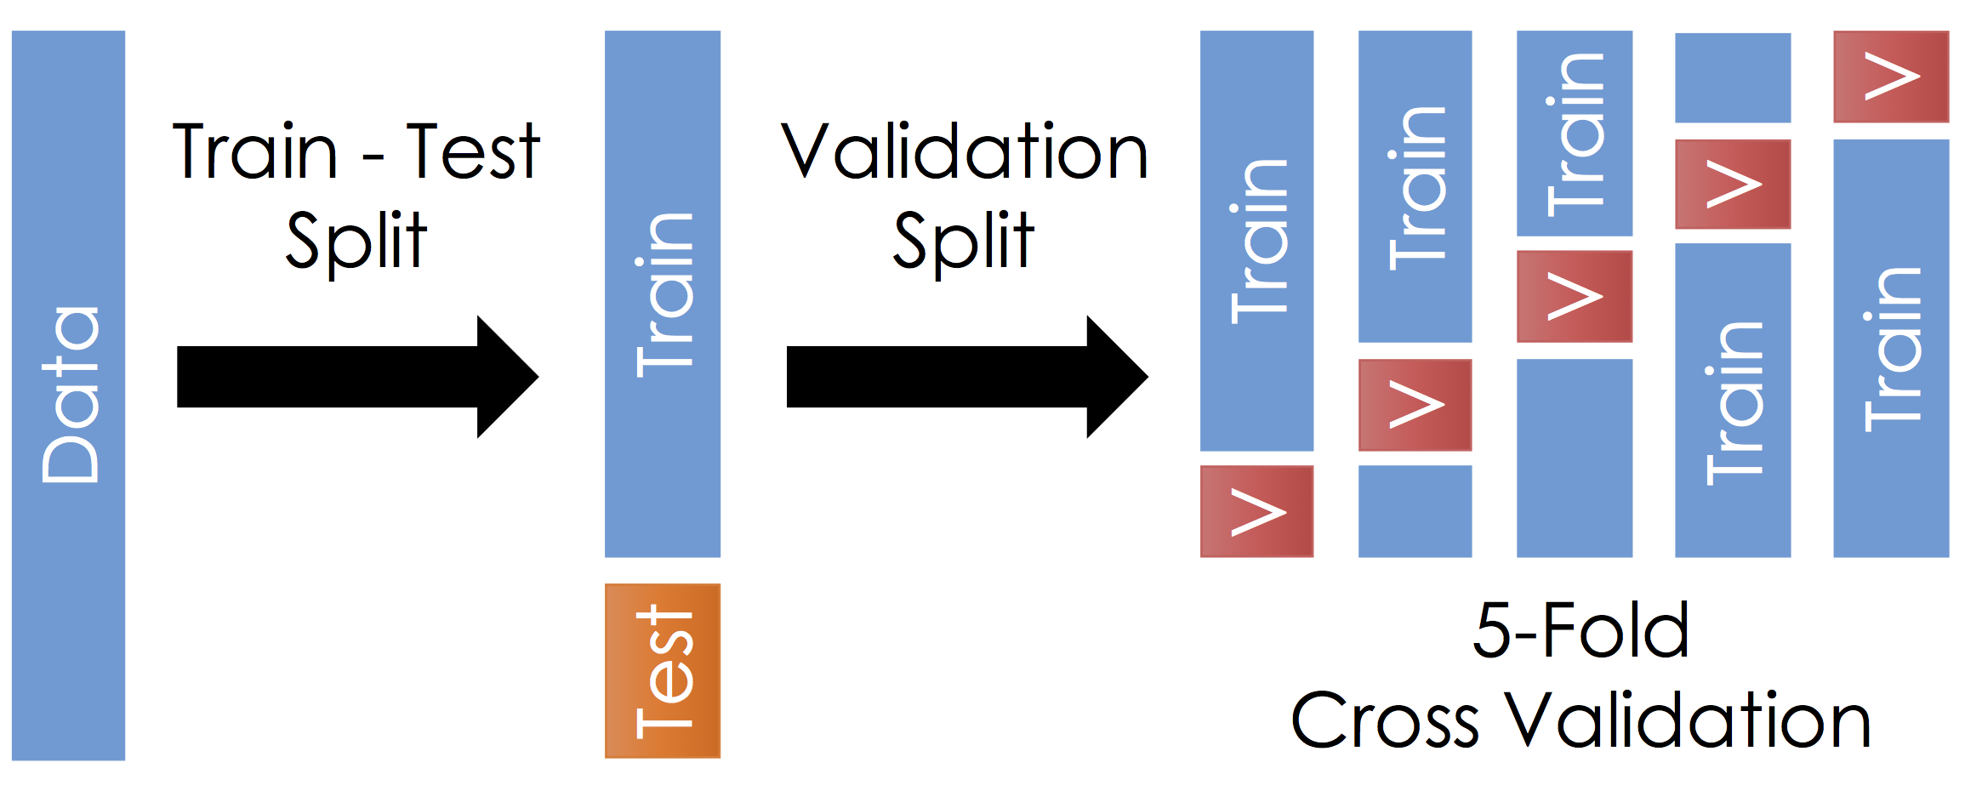
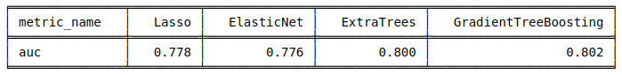
Modeling and Evaluation
Model selection: 5 fold CV
4 models: Lasso, ElasticNet, ExtraTrees, GradientTreeBoosting are evaluated using 5 fold CV on train data. The evaluation is done based on average of metrics for each validation part.
As a main evaluation metric is selected AUC.
Linear models (Lasso, ElasticNet) performance is low compared to DecisionTree based models (ExtraTrees, GradientTreeBoosting), which was expected as we have investigated that our data is mostly non liner.
So for further processing only ExtraTrees and GradientTreeBoosting are selected.
AUC:
The probability that model will rank a randomly chosen positive instance higher than a randomly chosen negative one (the probability that for a randomly chosen successful launch model will predict higher market share than a randomly chosen not successful launch).
Notes:
The ROC curve is a popular graphic for simultaneously displaying the two types of errors for all possible thresholds. The overall performance of a classifier, summarized over all possible thresholds, is given by the area under the (ROC) curve (AUC). An ideal ROC curve will hug the top left corner, so the larger the AUC the better the classifier.

Slide 20
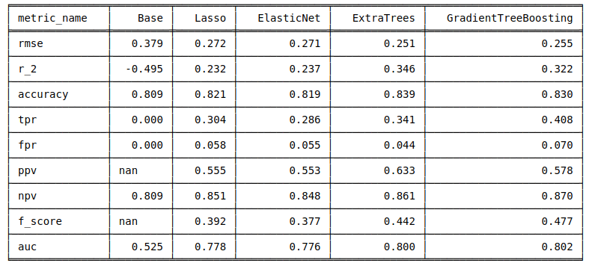
Modeling and Evaluation
Back up slide
Model selection: 5 fold CV
As expected Lasso and ElasticNet performance are almost similar and their performance is low compared to DecisionTree models, which is also expected as we investigated that our data mostly is non linear.
If we compare GradientTreeBoosting and ExtraTrees then we can notice that their performances are comparable: mean validation RMSE is almost equal and AUC is almost equal. We see some difference for TPR (true positive ratio - When it is actually Y, how often does it predict Y?) and FPR (false positive ratio - When it is actually N, how often does it predict Y?) metrics for given 0.7% success threshold. As we can see both are bigger for GradientTreeBoosting based model (tpr: 0.408 vs 0.341, fpr: 0.070 vs 0.044). So what does it mean? We can assume that GradientTreeBoosting based model learned more from data than ExtraTrees (as it is more complex model than ExtraTrees), so it can differentiate more succesful launches, but together with that the FPR is more by 2.6pp, which is not good from bussiness prospective. So GradientTreeBoosting based models pays FPR increase cost (by 2.6pp) for having higher TPR by 6.7pp.
All models have low TPR, which is a result of having imbalanced dataset (only 19% are successes in dataset).
Notes:
The ROC curve is a popular graphic for simultaneously displaying the two types of errors for all possible thresholds. The overall performance of a classifier, summarized over all possible thresholds, is given by the area under the (ROC) curve (AUC). An ideal ROC curve will hug the top left corner, so the larger the AUC the better the classifier.

Slide 21
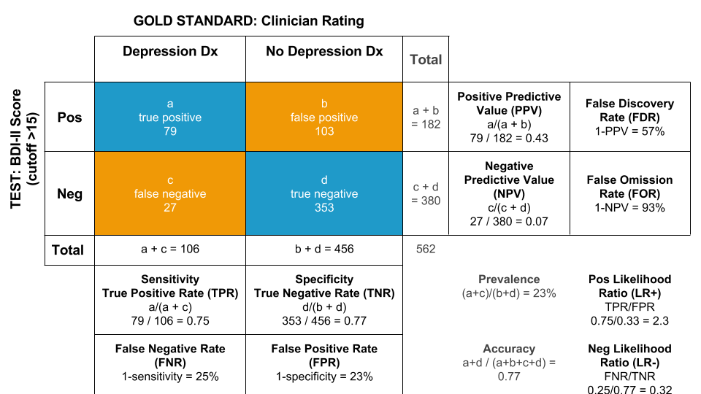
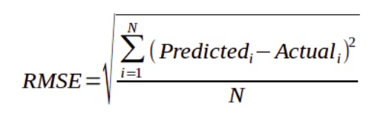
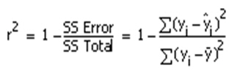
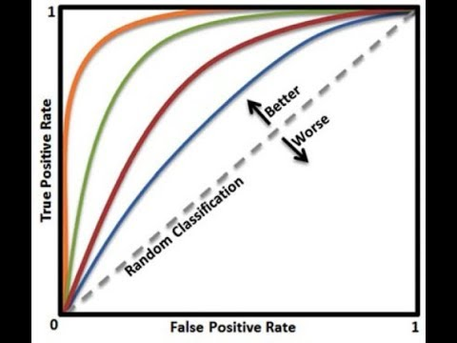
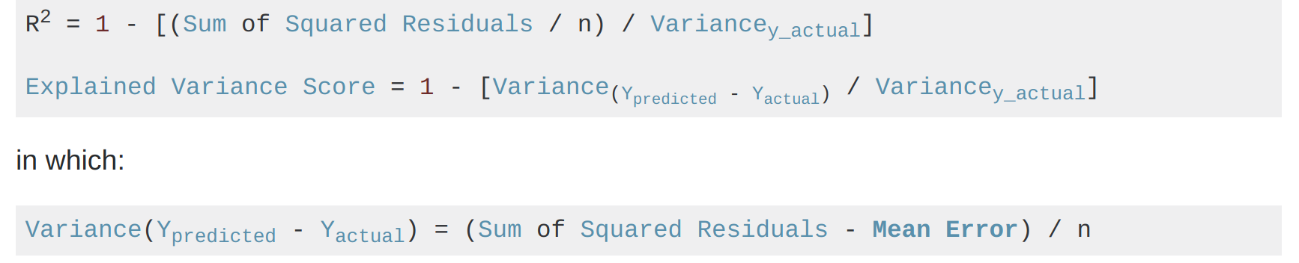
Modeling and Evaluation
Back up slide

Slide 22
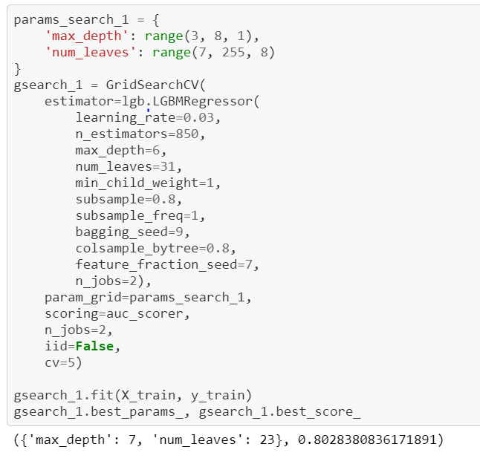
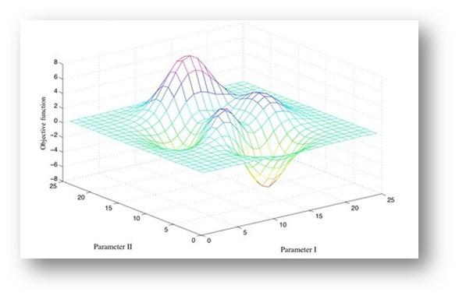
Modeling and Evaluation
Back up slide
Models hyper-parameters tuning
Our selected 2 models are ensembles of Decision Trees. They have hyper-parameters, which have tuned for better
handling overfitting and delivering more accurate CV results.
Some important parameters are:
n_estimators – number of decision trees in ensemble
max_depth – the maximum possible depth of tree
feature_fraction – the ratio of selected features for each training iteration
min_data_in_leaf – minimal number of data in one leaf
Some of parameters are responsible for complexity and some others trying to deal with overfitting.
There are different techniques for hyper-parameters tuning in ML, but we selected the simplest one: GridSearch with CV.

Slide 23
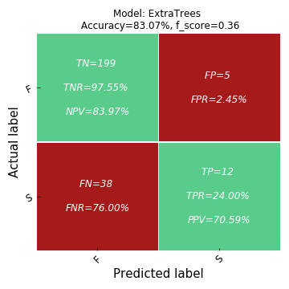

Modeling and Evaluation
Testing on 15% of data - 50 successes, 204 failures
ExtraTrees is conservative:
almost does not predict wrong successes (5 from 204, 2.45%), but it classifies a lot of actual successes as failures (12 from 50, 24.00%).
GradientTreeBoosting is risky:
in some cases it wrongly classifies actual failure as a success (11 from 204, 5.39%)), but it approximately 2 times more correctly classifies successes (22 from 50, 44.00%).
So which model to select?
Solution: Ensemble of both models with averaged prediction.
TPR: True positive ratio or Recall – Probability that model predicts success when it is actual success
FPR: False positive ratio – Probability that model predicts success when it is actual failure
PPV: Positive predictive value or Precision – Probability that it is actual success when model predicted success
Notes:
You estimating the true value based on your data. True value is a fixed but unknown quantity. In contrast, your estimate is a random variable as it depends on your data xx which was generated from your data generating process. Thus, you realize that you get different estimates each time you repeat your study.
The above understanding leads to the following methodology to assess where the true parameter is in relation to your estimate. Define an interval, I≡[lb(x),ub(x)]I≡[lb(x),ub(x)] with the following property:
P(θ∈I)=0.95
An interval constructed like the above is what is called a confidence interval. Since, the true value is unknown but fixed, the true value is either in the interval or outside the interval. The confidence interval then is a statement about the likelihood that the interval we obtain actually has the true parameter value. Thus, the probability statement is about the interval (i.e., the chances that interval which has the true value or not) rather than about the location of the true parameter value.
As a result, to express uncertainty in our knowledge after an experiment, the frequentist approach uses a "confidence interval" -- a range of values designed to include the true value of the parameter with some minimum probability, say 95%. A frequentist will design the experiment and 95% confidence interval procedure so that out of every 100 experiments run start to finish, at least 95 of the resulting confidence intervals will be expected to include the true value of the parameter. The other 5 might be slightly wrong, or they might be complete nonsense -- formally speaking that's ok as far as the approach is concerned, as long as 95 out of 100 inferences are correct. (Of course we would prefer them to be slightly wrong, not total nonsense.)
A commonly used formula for a binomial confidence interval relies on approximating the distribution of error about a binomially-distributed observation, {\displaystyle {\hat {p}}}, with a normal distribution.^{[2]} This approximation is based on the central limit theorem and is unreliable when the sample size is small or the success probability is close to 0 or 1.^{[3]}
Using the normal approximation, the success probability p is estimated as
[p - z * (p* (1 - p) / n)^(½), p + z * (p* (1 - p) / n)^(½)]
where p = n_success / n and and z is the 1 - alpha / 2 quantile of a standard normal distribution (i.e., the probit) corresponding to the target error rate alpha. For a 95% confidence level, the error alpha =1-0.95=0.05, so 1-alpha/2=0.975 and z = 1.96. P(Z > z) = alpha/2

Slide 24
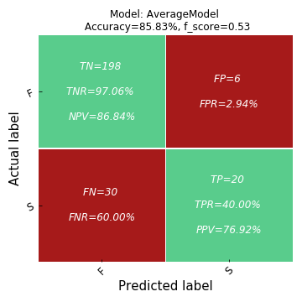
Modeling and Evaluation
Testing on 15% of data - 50 successes, 204 failures
As we can see from business point of view the AverageModel is better than each single model: it has more TPR than ExtraTrees (40% vs 24%) and less FPR than GradientTreeBoosting (2.94% vs 5.39%). It has PPV 76.92% (when it predicts success then in 76.92% cases it will be correct) with 95% confidence interval: [0.61, 0.93] .
So as final model we will take AverageModel.
Notes:
You estimating the true value based on your data. True value is a fixed but unknown quantity. In contrast, your estimate is a random variable as it depends on your data xx which was generated from your data generating process. Thus, you realize that you get different estimates each time you repeat your study.
The above understanding leads to the following methodology to assess where the true parameter is in relation to your estimate. Define an interval, I≡[lb(x),ub(x)]I≡[lb(x),ub(x)] with the following property:
P(θ∈I)=0.95
An interval constructed like the above is what is called a confidence interval. Since, the true value is unknown but fixed, the true value is either in the interval or outside the interval. The confidence interval then is a statement about the likelihood that the interval we obtain actually has the true parameter value. Thus, the probability statement is about the interval (i.e., the chances that interval which has the true value or not) rather than about the location of the true parameter value.
As a result, to express uncertainty in our knowledge after an experiment, the frequentist approach uses a "confidence interval" -- a range of values designed to include the true value of the parameter with some minimum probability, say 95%. A frequentist will design the experiment and 95% confidence interval procedure so that out of every 100 experiments run start to finish, at least 95 of the resulting confidence intervals will be expected to include the true value of the parameter. The other 5 might be slightly wrong, or they might be complete nonsense -- formally speaking that's ok as far as the approach is concerned, as long as 95 out of 100 inferences are correct. (Of course we would prefer them to be slightly wrong, not total nonsense.)
A commonly used formula for a binomial confidence interval relies on approximating the distribution of error about a binomially-distributed observation, {\displaystyle {\hat {p}}}, with a normal distribution.^{[2]} This approximation is based on the central limit theorem and is unreliable when the sample size is small or the success probability is close to 0 or 1.^{[3]}
Using the normal approximation, the success probability p is estimated as
[p - z * (p* (1 - p) / n)^(½), p + z * (p* (1 - p) / n)^(½)]
where p = n_success / n and and z is the 1 - alpha / 2 quantile of a standard normal distribution (i.e., the probit) corresponding to the target error rate alpha. For a 95% confidence level, the error alpha =1-0.95=0.05, so 1-alpha/2=0.975 and z = 1.96. P(Z > z) = alpha/2

Slide 25
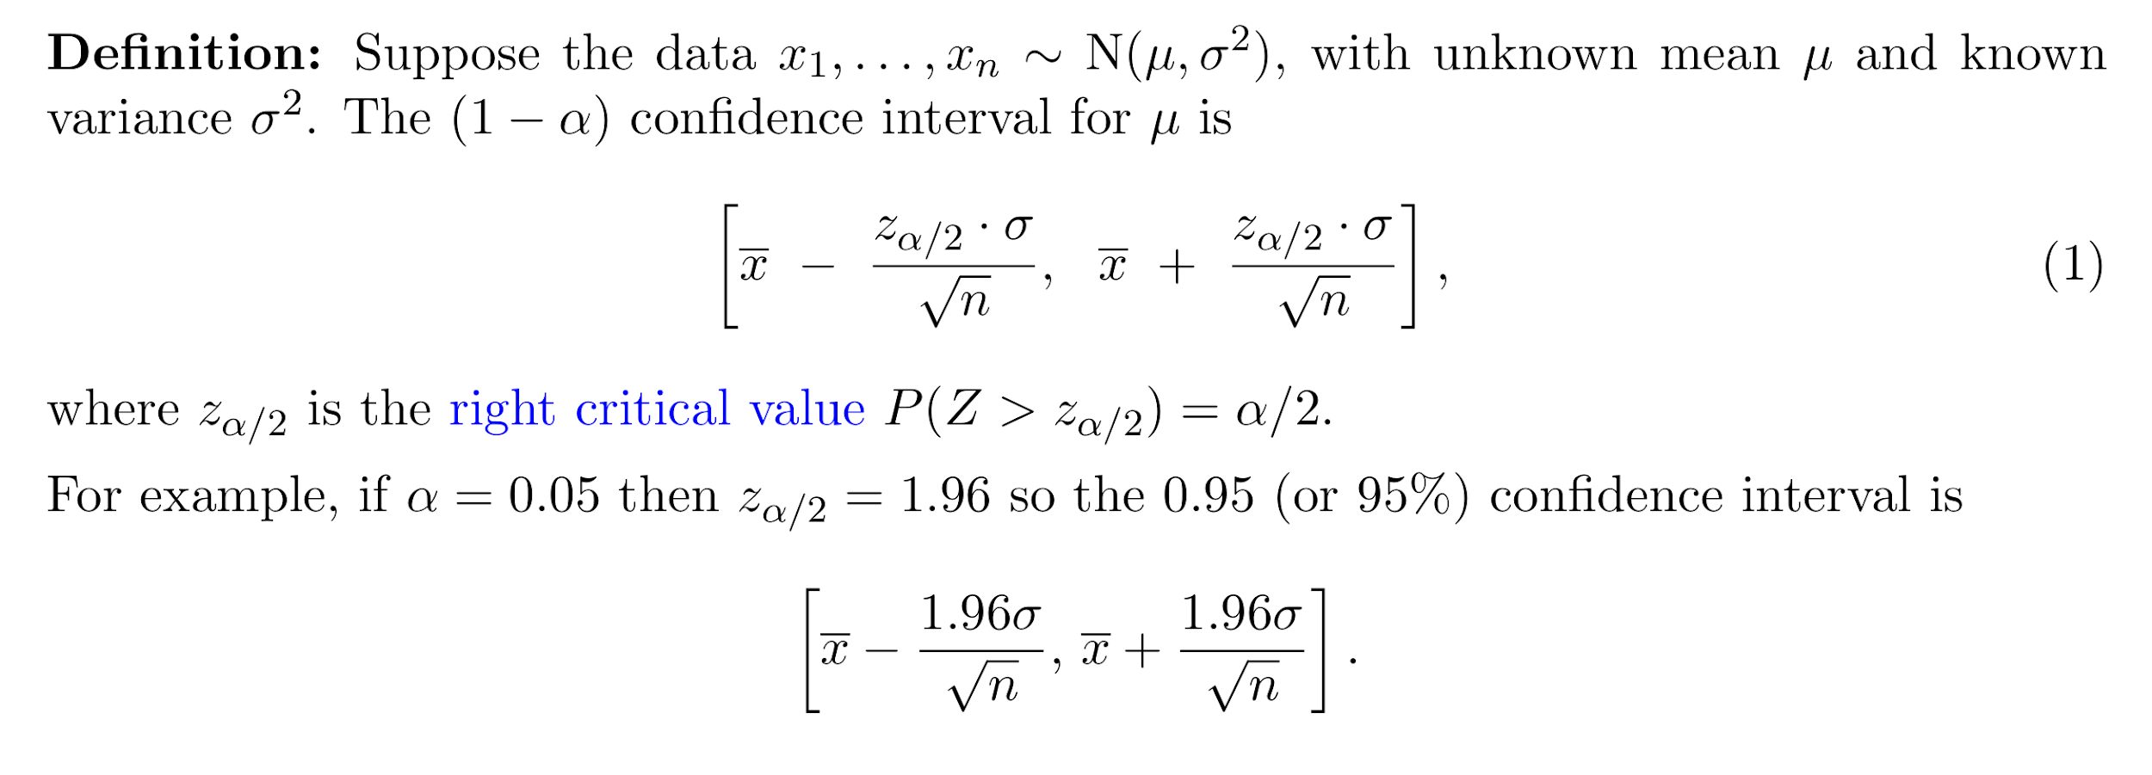
Modeling and Evaluation

Slide 26
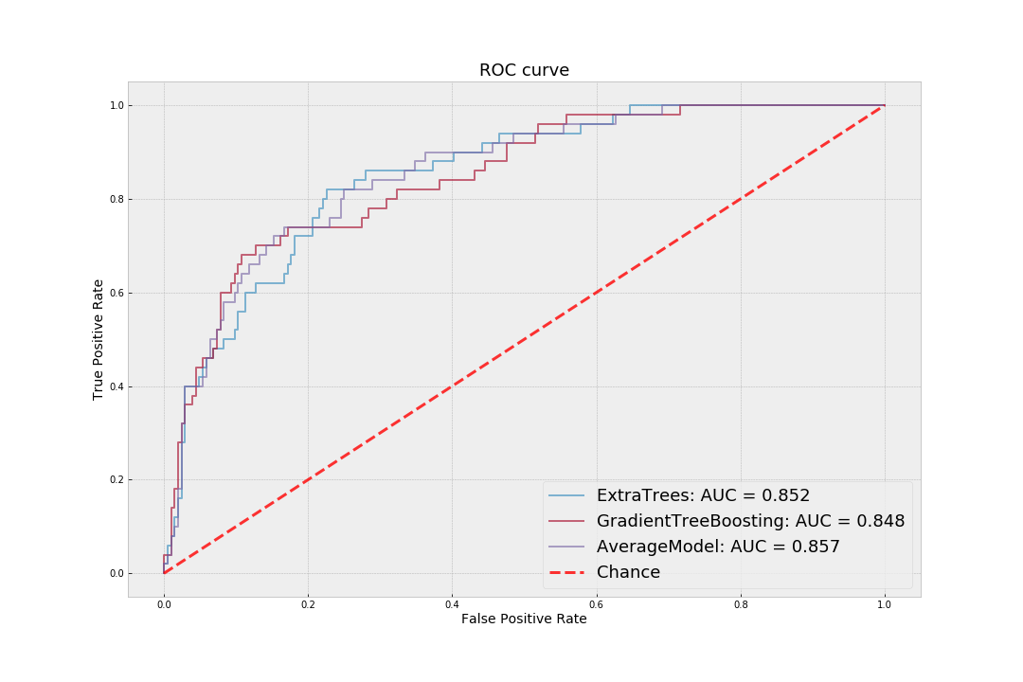
Modeling and Evaluation
Back up slide
ROC curve on Test data

Slide 27
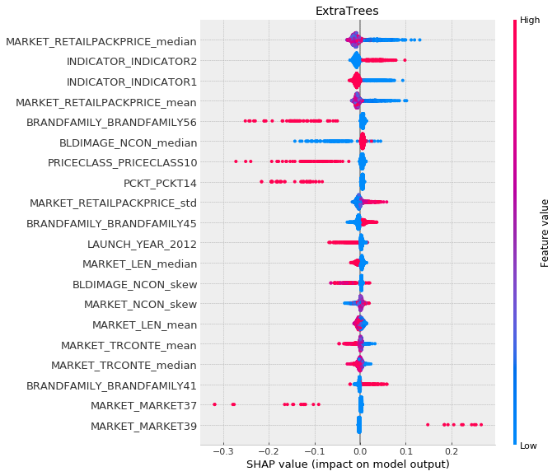
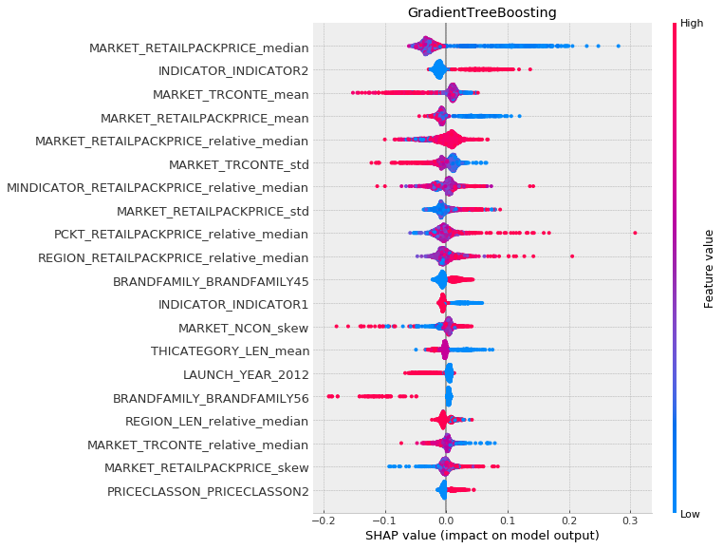
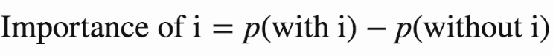
Modeling and Evaluation
Important predictors
From plots we can see that for both models MARKET_RETAILPACKPRICE_median (the median of RETAILPACKPRICE in each MARKET) is the most important feature and when this value is small then on average success probability is higher.
At a very high level, Shapley values calculate the importance of a predictor by comparing what a model predicts with and without the predictor. A prediction can be explained by assuming that each predictor value of the instance is a “player” in a game where the prediction is the payout. The Shapley value – a method from coalitional game theory – tells us how to fairly distribute the “payout” among the predictors.
Notes:
You estimating the true value based on your data. True value is a fixed but unknown quantity. In contrast, your estimate is a random variable as it depends on your data xx which was generated from your data generating process. Thus, you realize that you get different estimates each time you repeat your study.
The above understanding leads to the following methodology to assess where the true parameter is in relation to your estimate. Define an interval, I≡[lb(x),ub(x)]I≡[lb(x),ub(x)] with the following property:
P(θ∈I)=0.95
An interval constructed like the above is what is called a confidence interval. Since, the true value is unknown but fixed, the true value is either in the interval or outside the interval. The confidence interval then is a statement about the likelihood that the interval we obtain actually has the true parameter value. Thus, the probability statement is about the interval (i.e., the chances that interval which has the true value or not) rather than about the location of the true parameter value.
As a result, to express uncertainty in our knowledge after an experiment, the frequentist approach uses a "confidence interval" -- a range of values designed to include the true value of the parameter with some minimum probability, say 95%. A frequentist will design the experiment and 95% confidence interval procedure so that out of every 100 experiments run start to finish, at least 95 of the resulting confidence intervals will be expected to include the true value of the parameter. The other 5 might be slightly wrong, or they might be complete nonsense -- formally speaking that's ok as far as the approach is concerned, as long as 95 out of 100 inferences are correct. (Of course we would prefer them to be slightly wrong, not total nonsense.)
A commonly used formula for a binomial confidence interval relies on approximating the distribution of error about a binomially-distributed observation, {\displaystyle {\hat {p}}}, with a normal distribution.^{[2]} This approximation is based on the central limit theorem and is unreliable when the sample size is small or the success probability is close to 0 or 1.^{[3]}
Using the normal approximation, the success probability p is estimated as
[p - z * (p* (1 - p) / n)^(½), p + z * (p* (1 - p) / n)^(½)]
where p = n_success / n and and z is the 1 - alpha / 2 quantile of a standard normal distribution (i.e., the probit) corresponding to the target error rate alpha. For a 95% confidence level, the error alpha =1-0.95=0.05, so 1-alpha/2=0.975 and z = 1.96. P(Z > z) = alpha/2

Slide 28
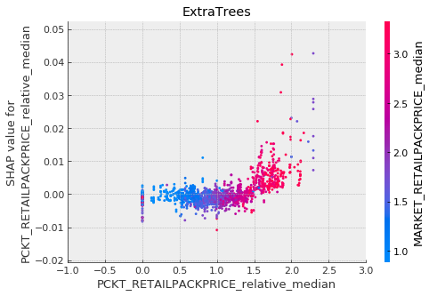
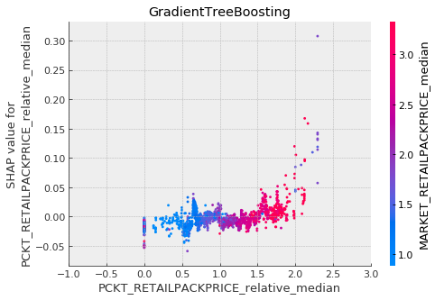
Modeling and Evaluation
Important predictors
These plots show the PCKT_RETAILPACKPRICE_relative_median values vs. its SHAP values across all dataset. Colors of points shows the values of MARKET_RETAILPACKPRICE_median. From these plots we can say that for some products, which are expensive from their PCKT median more than 1.5 times, then on average they have more success probability according to our models.
Notes:
You estimating the true value based on your data. True value is a fixed but unknown quantity. In contrast, your estimate is a random variable as it depends on your data xx which was generated from your data generating process. Thus, you realize that you get different estimates each time you repeat your study.
The above understanding leads to the following methodology to assess where the true parameter is in relation to your estimate. Define an interval, I≡[lb(x),ub(x)]I≡[lb(x),ub(x)] with the following property:
P(θ∈I)=0.95
An interval constructed like the above is what is called a confidence interval. Since, the true value is unknown but fixed, the true value is either in the interval or outside the interval. The confidence interval then is a statement about the likelihood that the interval we obtain actually has the true parameter value. Thus, the probability statement is about the interval (i.e., the chances that interval which has the true value or not) rather than about the location of the true parameter value.
As a result, to express uncertainty in our knowledge after an experiment, the frequentist approach uses a "confidence interval" -- a range of values designed to include the true value of the parameter with some minimum probability, say 95%. A frequentist will design the experiment and 95% confidence interval procedure so that out of every 100 experiments run start to finish, at least 95 of the resulting confidence intervals will be expected to include the true value of the parameter. The other 5 might be slightly wrong, or they might be complete nonsense -- formally speaking that's ok as far as the approach is concerned, as long as 95 out of 100 inferences are correct. (Of course we would prefer them to be slightly wrong, not total nonsense.)
A commonly used formula for a binomial confidence interval relies on approximating the distribution of error about a binomially-distributed observation, {\displaystyle {\hat {p}}}, with a normal distribution.^{[2]} This approximation is based on the central limit theorem and is unreliable when the sample size is small or the success probability is close to 0 or 1.^{[3]}
Using the normal approximation, the success probability p is estimated as
[p - z * (p* (1 - p) / n)^(½), p + z * (p* (1 - p) / n)^(½)]
where p = n_success / n and and z is the 1 - alpha / 2 quantile of a standard normal distribution (i.e., the probit) corresponding to the target error rate alpha. For a 95% confidence level, the error alpha =1-0.95=0.05, so 1-alpha/2=0.975 and z = 1.96. P(Z > z) = alpha/2

Slide 29
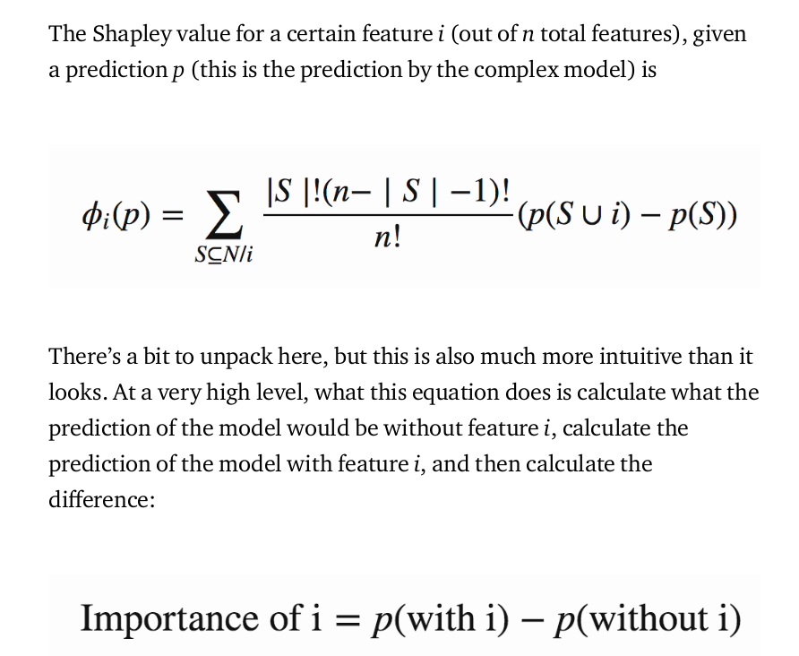
Modeling and Evaluation
Back up slide
Predictors importances
However, there are two different ways to interpret this:
1. On a global level. Looking at the entire dataset, which features did the algorithm nd most predictive? XGBoost’s get_score() function - which counts how many times a feature was used to split the data – is an example of considering global feature importance, since it looks at what was learned from all the data.
2. On a local level. Maybe, across all individuals, age was the most important feature, and younger people are much more likely to like computer games. But if Frank is a 50-year-old who works as a video game tester, it’s likely that his occupation is going to be much more signi cant than his age in determining whether he likes computer games. Identifying which features were most important for Frank specifcally involves finding feature importances on a ‘local’ – individual – level.
In summary, Shapley values calculate the importance of a feature by comparing what a model predicts with and without the feature. However, since the order in which a model sees features can a ect its predictions, this is done in every possible order, so that the features are fairly compared.
Traditional feature importance algorithms will tell
us which features are most important across the entire population, but this one-size-fits-all approach doesn’t always apply to each individual customer. A factor that is an important driver for one customer may be a non-factor for another. By looking only at the global trends, these individual variations can get lost, with only the most common denominators remaining. With individual-level SHAP values, we can pinpoint which factors are most impactful for each customer, allowing
us to customize our next actions accordingly.

Slide 30
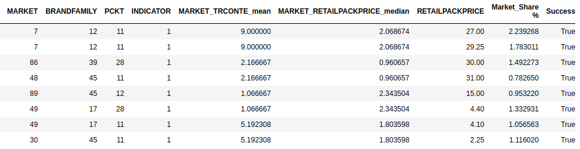

Modeling and Evaluation
Final prediction for 29 new launches
8 successful launches
The above explanation shows features each contributing to push the model output from the base value (the average model output over the training dataset we passed) to the model output. Features pushing the prediction higher are shown in red, those pushing the prediction lower are in blue.
Notes:
You estimating the true value based on your data. True value is a fixed but unknown quantity. In contrast, your estimate is a random variable as it depends on your data xx which was generated from your data generating process. Thus, you realize that you get different estimates each time you repeat your study.
The above understanding leads to the following methodology to assess where the true parameter is in relation to your estimate. Define an interval, I≡[lb(x),ub(x)]I≡[lb(x),ub(x)] with the following property:
P(θ∈I)=0.95
An interval constructed like the above is what is called a confidence interval. Since, the true value is unknown but fixed, the true value is either in the interval or outside the interval. The confidence interval then is a statement about the likelihood that the interval we obtain actually has the true parameter value. Thus, the probability statement is about the interval (i.e., the chances that interval which has the true value or not) rather than about the location of the true parameter value.
As a result, to express uncertainty in our knowledge after an experiment, the frequentist approach uses a "confidence interval" -- a range of values designed to include the true value of the parameter with some minimum probability, say 95%. A frequentist will design the experiment and 95% confidence interval procedure so that out of every 100 experiments run start to finish, at least 95 of the resulting confidence intervals will be expected to include the true value of the parameter. The other 5 might be slightly wrong, or they might be complete nonsense -- formally speaking that's ok as far as the approach is concerned, as long as 95 out of 100 inferences are correct. (Of course we would prefer them to be slightly wrong, not total nonsense.)
A commonly used formula for a binomial confidence interval relies on approximating the distribution of error about a binomially-distributed observation, {\displaystyle {\hat {p}}}, with a normal distribution.^{[2]} This approximation is based on the central limit theorem and is unreliable when the sample size is small or the success probability is close to 0 or 1.^{[3]}
Using the normal approximation, the success probability p is estimated as
[p - z * (p* (1 - p) / n)^(½), p + z * (p* (1 - p) / n)^(½)]
where p = n_success / n and and z is the 1 - alpha / 2 quantile of a standard normal distribution (i.e., the probit) corresponding to the target error rate alpha. For a 95% confidence level, the error alpha =1-0.95=0.05, so 1-alpha/2=0.975 and z = 1.96. P(Z > z) = alpha/2

Slide 31


Next Steps
1
Data Related
Request for detailed information about
dataset features, so we can understand
technical and business specifications of
features. This will help to improve provided result.
More features about different market specifics.
More feature engineering.
2
Modeling Related
To try other Machine Learning algorithms such as
Neural Networks and Probabilistic Models.
To try other methods for hyper parameters tuning.
To try different approach: to treat problem directly
as classification problem (without estimating market
share value - to estimate product will be successful or not).

Slide 32
Q&A

